Slide 1
Stock Market
Predictions and Clustering
TASK 2 - Part 2
The Feynman Method
STAT-656 , March 2022
Abdullatif Alnuaimi
Pooja Hari Ambrish
Sachith Kumar Janjirala

Slide 2
The Feynman Method / Steps
Step 1:
Write down clearly and concisely what you are trying to learn.
Step 2:
Explain the concept in simple language.
Step 3:
Identify gaps in knowledge or things you can not relay clearly,
from Step 2.
Step 4:
Seek to solidify these concepts.

Slide 3
The Feynman Method / Step 1
We want to learn, for each of the time series data from a set, how to decompose the series by detecting seasonality using decompose() in R and Fast Fourier Transforms and interpret the results by understanding the time periods resulting from the output frequencies we get by applying the Fast Fourier Transforms.
How does using the Fast Fourier Transform help us extract the seasonality and how many of the significant frequencies do we then need to use from the output of the Fast Fourier Transform to account for seasonality in the data and to later use them as predictor variables for our clustering problem.

Slide 4
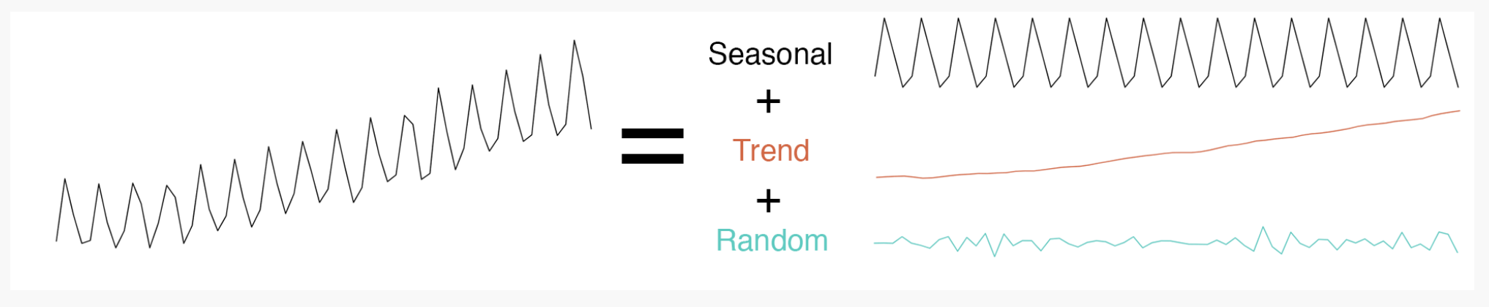
The Feynman Method / Step 2
Any time series (data measured over regular intervals of time) can be decomposed into 3 component series:
Seasonal: Data with pattern that repeat with a fixed time period.
Trend: The actual underlying trend of the time series data.
Random or Residual: Noise in the data that remains.

Slide 5
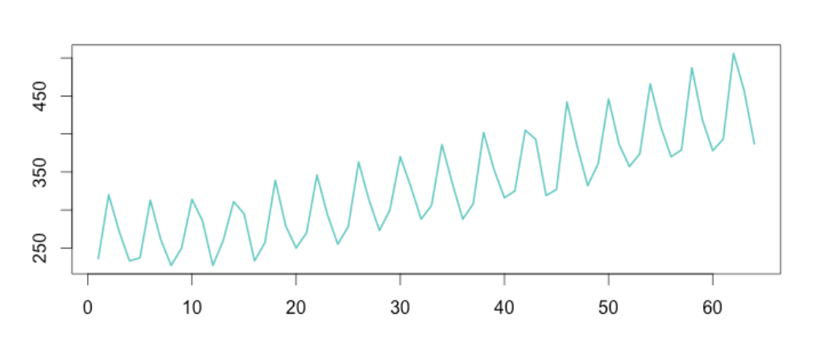
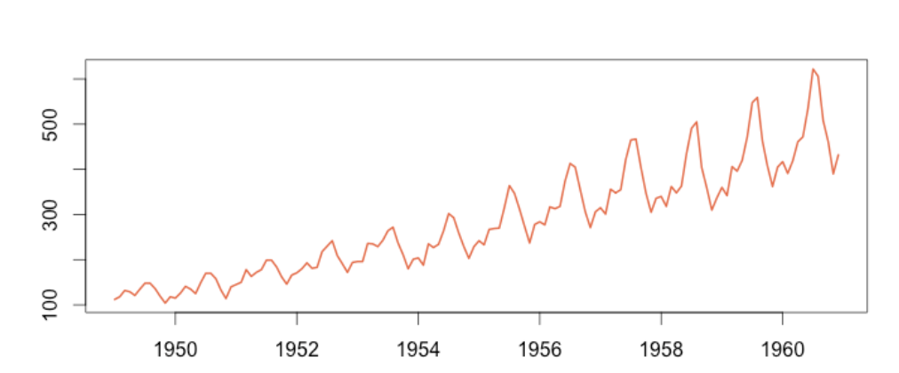
The Feynman Method / Step 2…contd.
For decomposing the time series we can use two types of models:
Additive Model:
when the variation of seasonality tends to remain same throughout the data.
A simplified model for time series when using additive model looks like:
Time Series = Seasonal + Trend + Random
Multiplicative Model:
when the variation of seasonality tends to increase with increase in time.
A simplified model for time series when using multiplicative model looks like: Time Series = Seasonal * Trend * Random

Slide 6
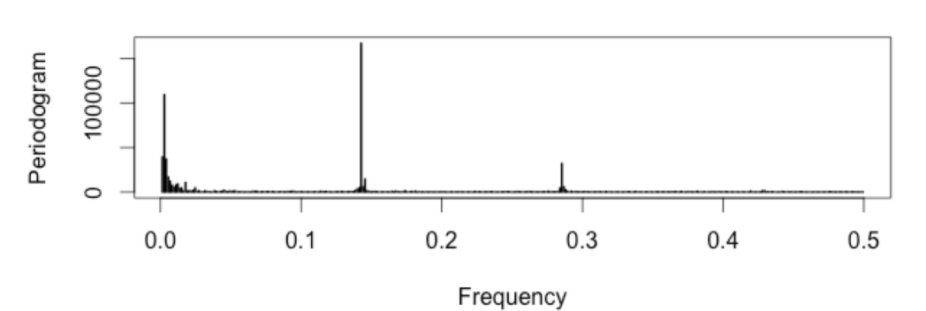
The Feynman Method / Step 2…contd.
Fourier Analysis converts a signal from its original domain to a representation in the frequency domain and vice versa.
Fourier transform takes a time-based data, measures every possible cycle, and return the overall amplitude, offset and rotation speed for every cycle that was found.
A periodogram is used to identify the dominant periods (or frequencies) of a time series. This can be a helpful tool for identifying the dominant cyclical behavior in a series, particularly when the cycles are not related to the commonly encountered monthly or quarterly seasonality.

Slide 7
The Feynman Method / Step 3
There are some questions that need more clarification or research to be clear to us:
How does Fast Fourier Transform differ from the regular fourier transform ?
How to analyze the frequencies of a model ?
How to check which frequencies are significant?

Slide 8
The Feynman Method / Step 4
The following reference (https://anomaly.io/detect-seasonality-using-fourier-transform-r/index.html) is used in order to get some explanations to the previous questions:
How does Fast Fourier Transform differ from the regular fourier transform ?
An efficient implementation that works with high number of complex computations and reduces the amount of computation time. so the real need to apply FFT is the speed and efficiency and that exactly what we need in our project for analysing stock data
How to analyze the frequencies of a model?
Starts with the smallest frequency as possible. For a signal made of 100 points, the smallest frequency possible is 1/100 = 0.01 Hz.
Decompose the entire signal by plotting it on a circle.
All the measurements are now on the circle in two dimensions. We call these “vectors”. Summing the vectors together give the final “power” of the frequency then produce periodogram
The frequencies with the highest power represent the greatest periodicity
How to check which frequencies are significant?
Check the frequency & power of periodogram. The frequency will be significant if it has high “power” , a peak in graph, represents the primary seasonality of our underlying metric.

Slide 9
Thank You!

